Slide 1

HEALTHCARE INTERFACE
PRESENTED BY:
SHIVANK SINGH
SNEHA SINGH
TANISHQ JADON
VISHAL GARG

Slide 2
CONTENT
PROBLEM STATEMENT
INTRODUCTION
USE CASES
FEATURES
FUTURE SCOPE
CONCLUSION

Slide 3
Problem Statement
● No information about the Doctors availability and specialization at the clinic.
● Long waiting queue for taking appointments and no surety of getting it.
● Clumsy prescription storage and losing it.
● No medical record.
● Inconvenient time schedule of appointment.
● Clinics do not have any record keeping system to check the progress and report of the clinic.

Slide 4
OBJECTIVE
The objective is to develop a healthcare system which is a web based project which includes registration of the patients, storing their details into system, doctor advice via video conferencing and lab reports facility, where patient can discuss health related problems and gets specialized doctors prescription.
●To maintain the patient's medical records
● To facilitate best medical facility at small towns where the lack of specialist.
●To provide the platform for both patients and doctors.
● E- healthcare helps in boosting up hospital range.

Slide 5
EXISTING SYSTEM VS PROPOSED SYSTEM
•Platforms provides the facility for online doctors prescription but for the diseases which needed long term treatment like cancer.
•Some application which provides nutritionist prescription Deliver the nutrition product based on deficiency. Again these app fails to satisfy regular patients need. Because which facilitate Registrations for users and discussion forum.

Slide 6
PROPOSED SYSTEM
The proposed system is designed to serve both the patient and doctors.
Patient can see the doctor's availability and specialization according to one's need.
View doctor details and request an appointment.
Prescription and reports can be accessed at a distant.
No worries about losing report and records.
Systematized appointment and record system.

Slide 7
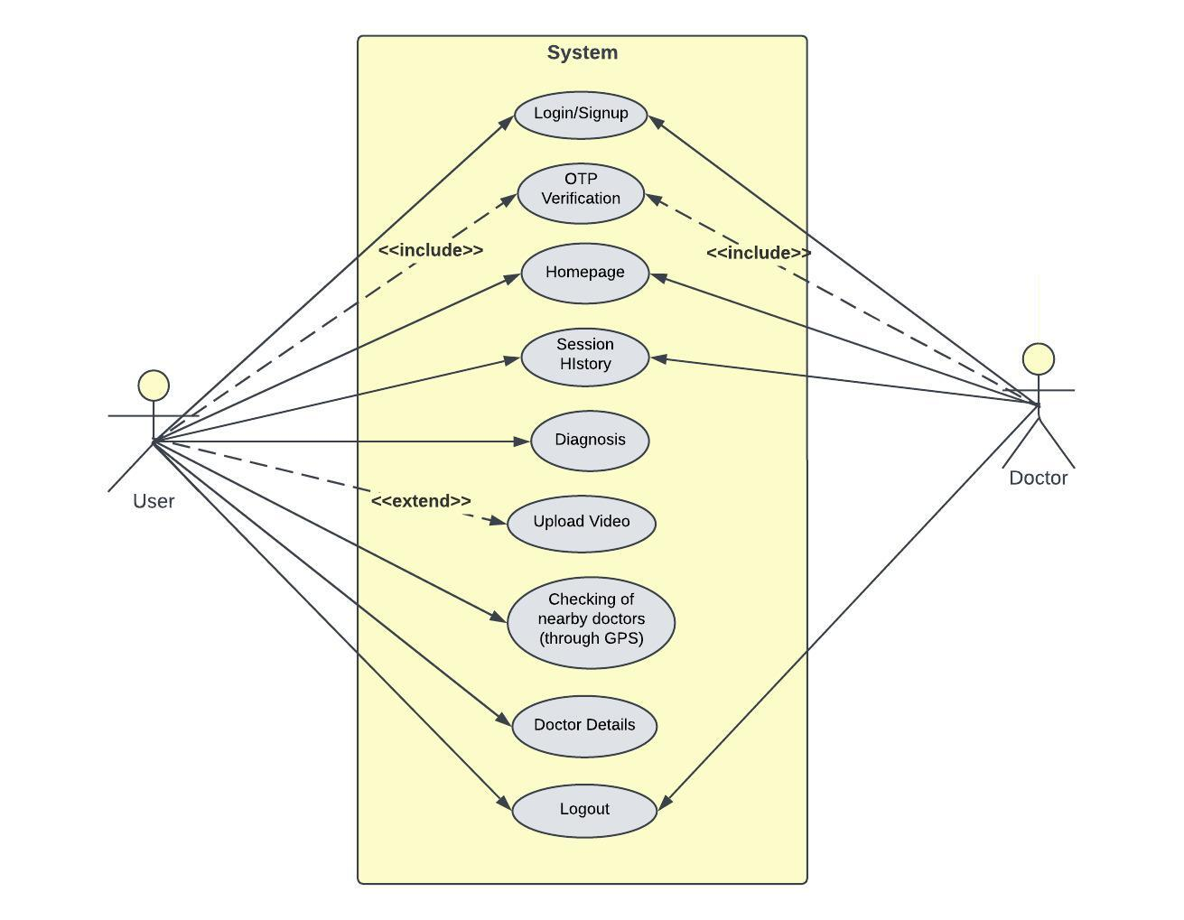
Use-case diagram

Slide 8
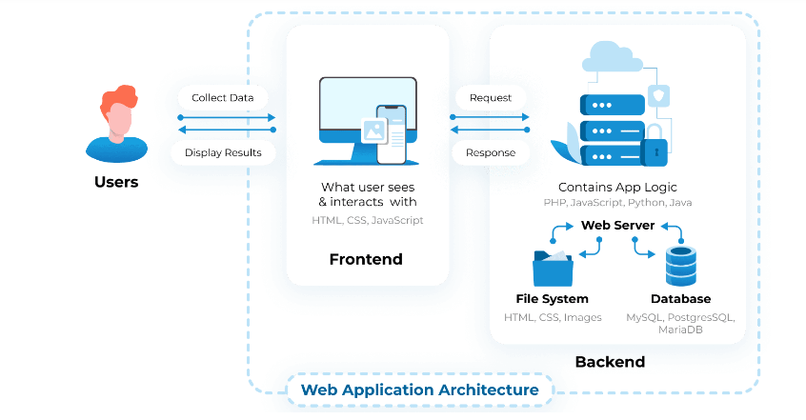

Slide 9
FEATURES
Data compression - video can be recorded by the patient, so that disease can be diagnosed in an efficient way by the doctor.
Save money – Deploying a medical chatbot helps to handle tasks efficiently without the need for extra resources. Healthcare bots are predicted to save $3.6 billion worldwide by 2023.
Real time interaction: Provide immediate response and user friendly.
Scalability: Ability to react with numerous users at the same time.

Slide 10
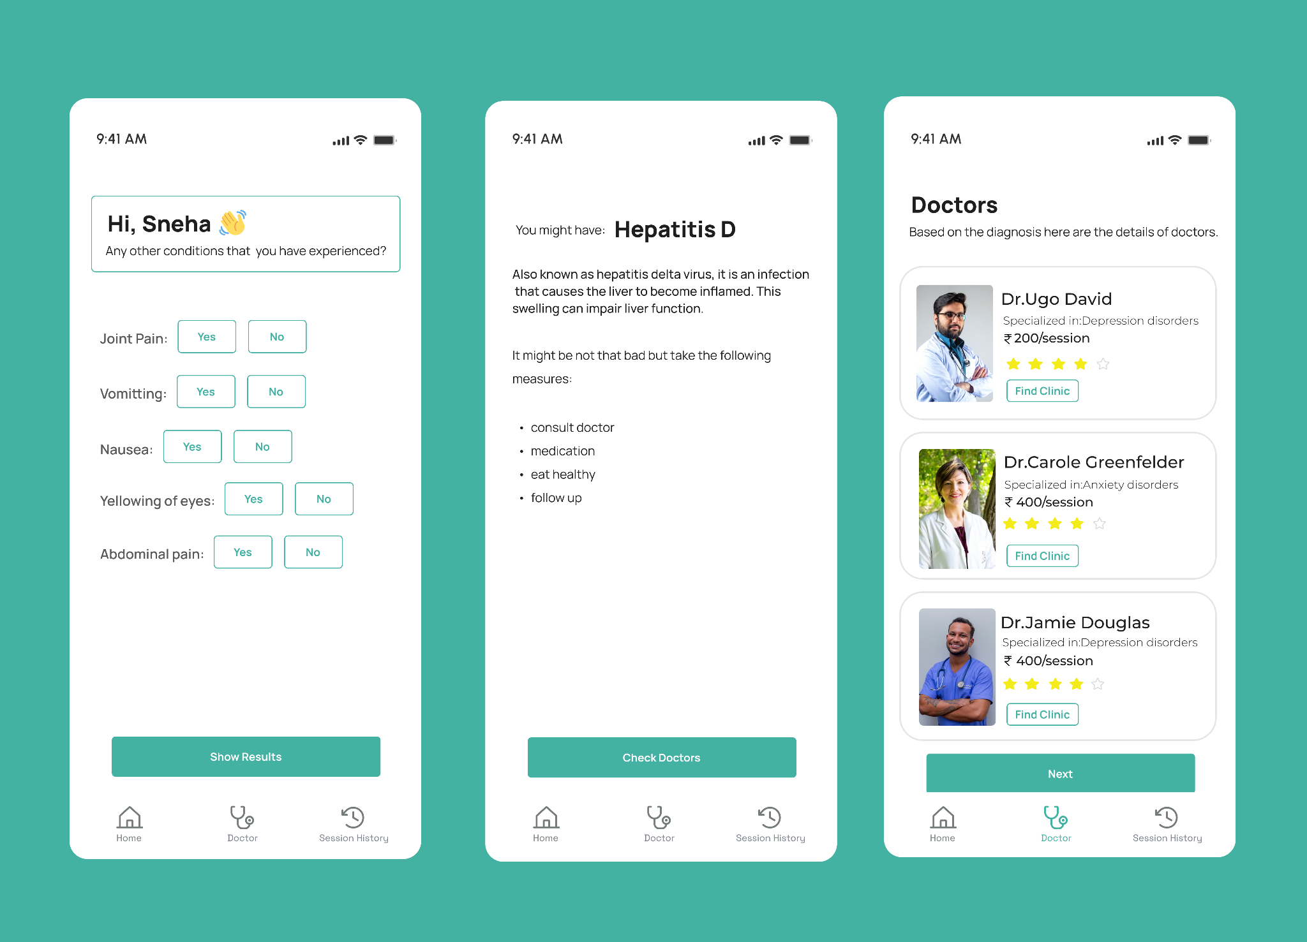
OUTPUT

Slide 11
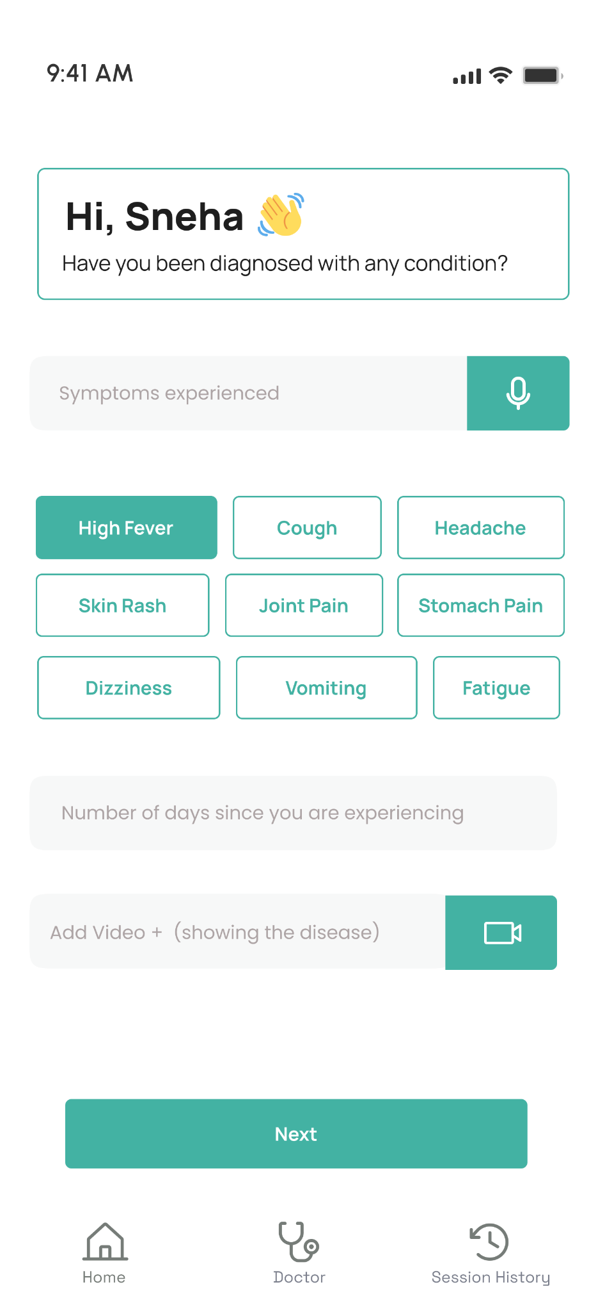
Our medical interface offers patients medical help for several common illnesses, including fever, cold, typhoid, malaria, jaundice, etc. And enable easy user handling
To save doctor time, a feature of video footage i.e.; data compression has been added in the interface in which the patient can make the video of the disease they are facing and upload it.

Slide 12
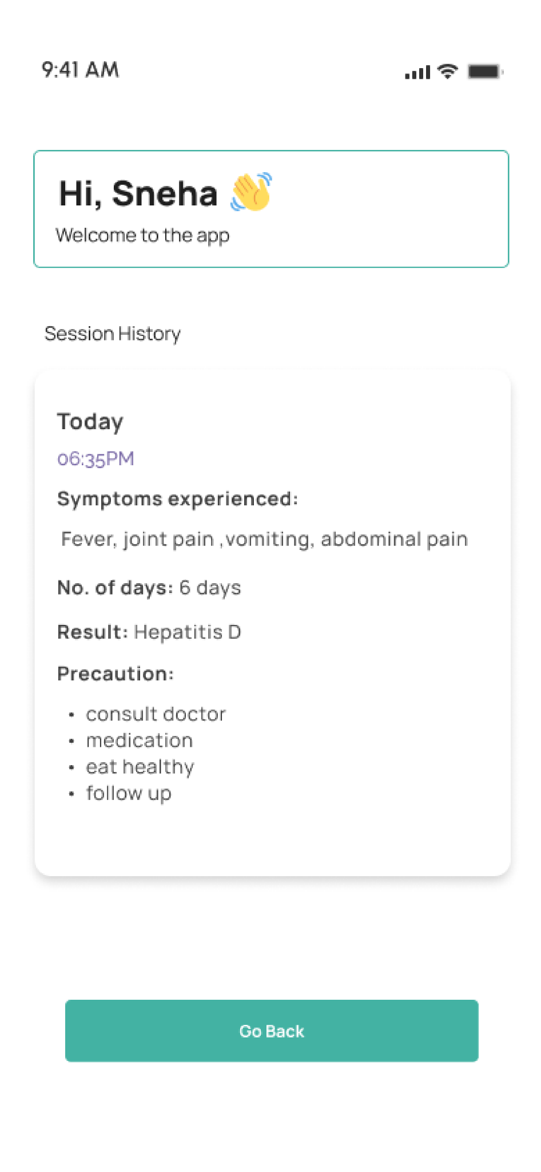
CONCLUSION
The Website Interface help to keep the update of patient health, track details of their condition and provide proper suggestion to the patient and also keep their medical records .

Slide 13
THANK YOU!!

